Slide 1

Department of Information Technology
A.P. Shah Institute of Technology
G.B.Road, Kasarvadavli, Thane(W), Mumbai-400615
UNIVERSITY OF MUMBAI
Academic Year 2019-2020

Slide 2
A Project Report on
Chatbot for Efficient Resource Allocation and Management
Submitted in partial fulfillment of the degree of
Bachelor of Engineering(Sem-7)
in
INFORMATION TECHNOLOGY
By
Manasi Ghadge(16104019)
Anuja Dhumale(16104034)
Gitika Daki(16104005)
Under the Guidance of
Guide: Dr. Uttam .D. Kolekar
Co-Guide: Nahid Shaikh

Slide 3
Project Conception and Initiation

Slide 4
1.1 Abstract
When considering an institution regardless, whether it is a school or university it is consequential that the students are edified in a congruous environment. This generalizes that the infrastructure should fascinate every requisite as cardinal or required by the students or the faculty in that environment.Present day process implies that all the work is done manually.

Slide 5
1.2 Objectives
To automate the process of manual allotment.
Overcome the manual errors that are ought to happen in the process.
Save time of the end users.

Slide 6
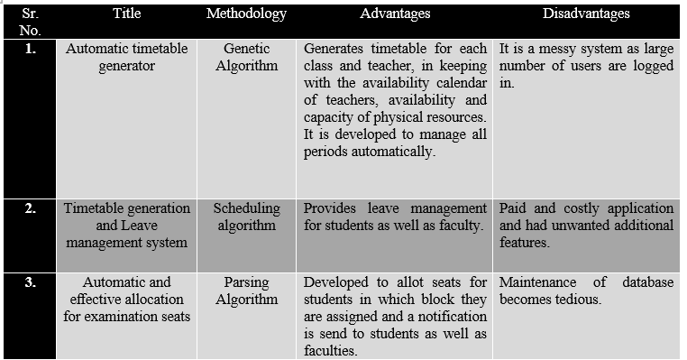
1.3 Literature Review

Slide 7
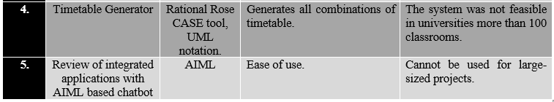

Slide 8
1.4 Problem Definition
To provide a web based application for eﬃcient allotment of infrastructure.”Chatbot For Eﬃcient Resource Allocation And Management” will be integrated with a Chatbot for utilized interaction.

Slide 9
1.5 Scope
Proposed System will provide comfort to the manpower and will avoid hamper in academics.
Provides with Chatbot in runtime of academics.
It will avoid inconsistencies visually perceiving that no lab session is missed due to any reason by providing alternate infrastructure options.
Additionally features provided like reservation and dynamic allocation due to any activities.

Slide 10
1.6 Technology stack
Chatbot: HTML, CSS, PHP, Javascript.
Website: HTML, CSS, PHP.
Database: PhpMyAdmin, SQL.

Slide 11
1.7 Benefits for environment & Society
Save time invested by faculties to find lab manually.
Reduce manpower.
Provide efficient infrastructure allotment.

Slide 12
2. Project Design

Slide 13
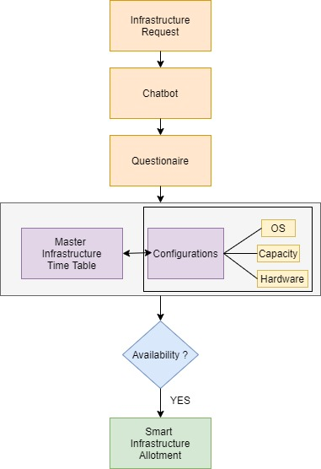
2.1 Proposed System

Slide 14
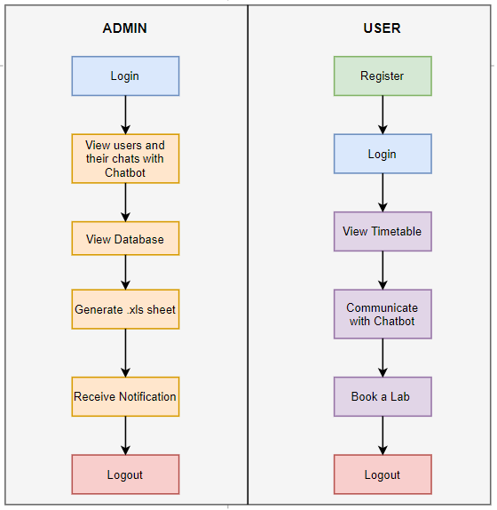
2.2 Design(Flow Of Modules)

Slide 15
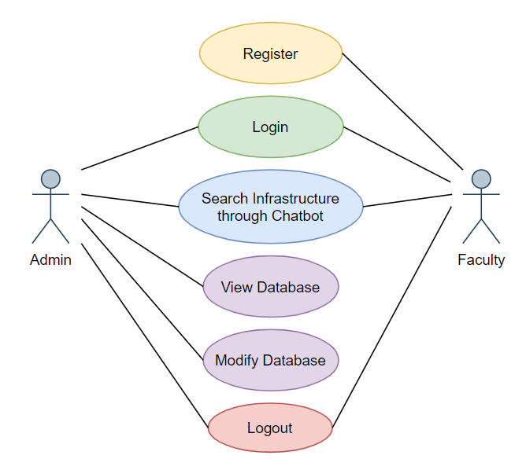
2.3 Description Of Use Case

Slide 16
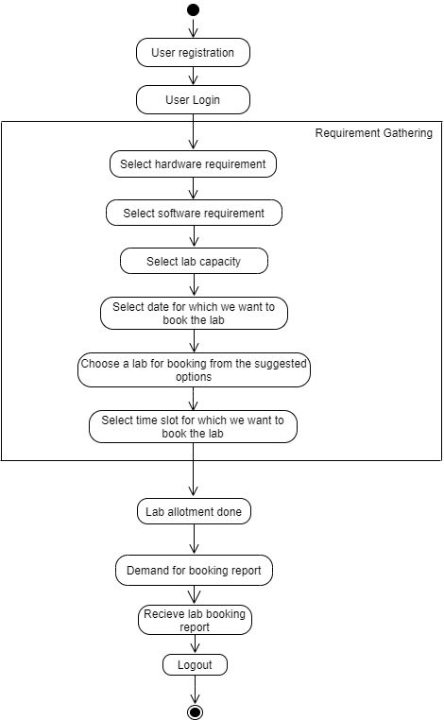
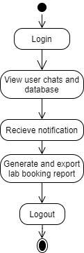
2.4 Activity diagram
USER ->
ADMIN ->

Slide 17
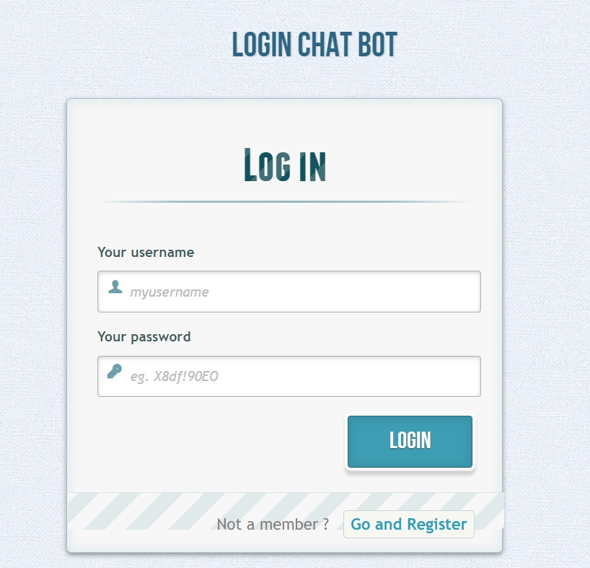
2.6 Module-1

Slide 18
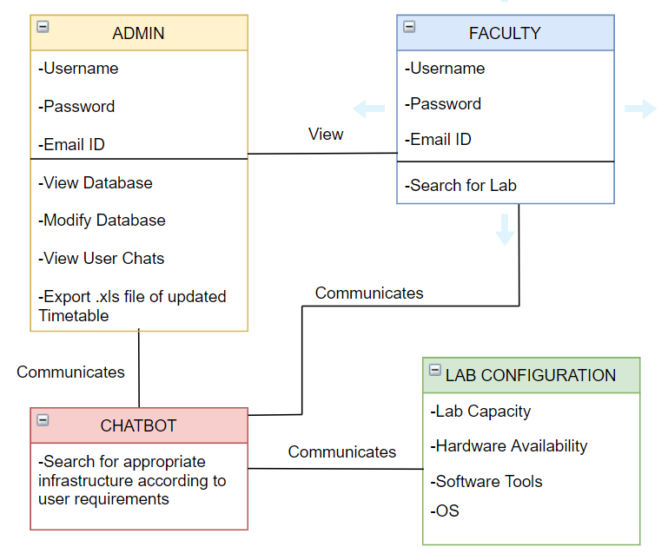
2.5 Class Diagram

Slide 19
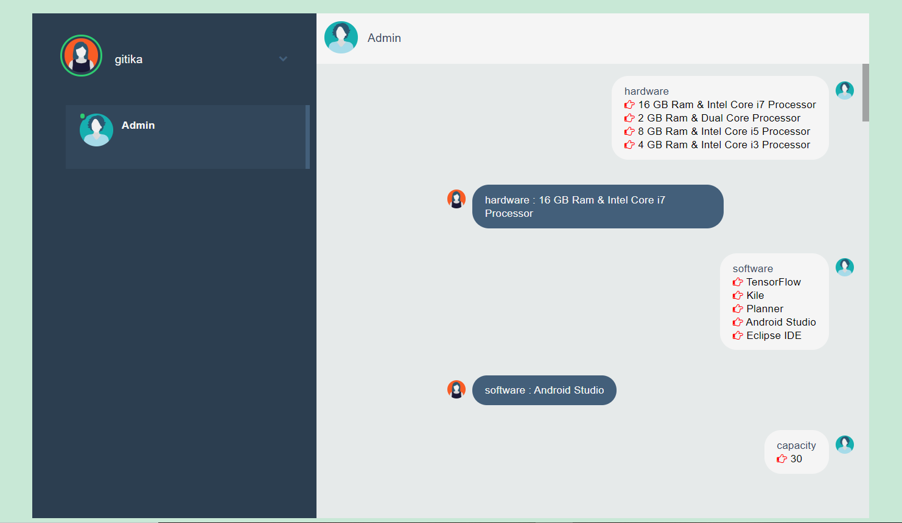
Module-2

Slide 20
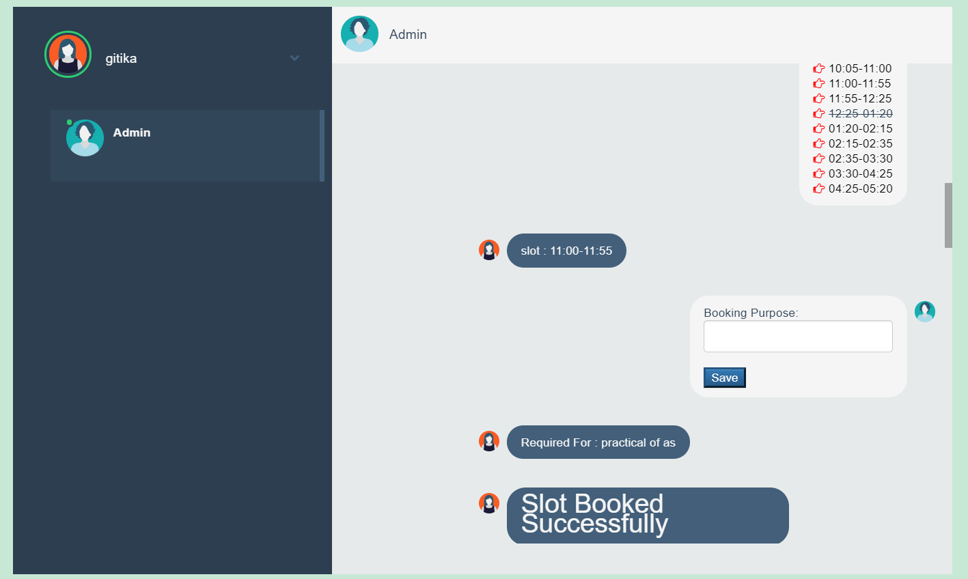
Module-n

Slide 21
2.7 References
1. Saritha M, Pranav Kiran Vaze, Pradeep, Mahesh N R,on”Automatic Time Table Generator”,International Journal of Advanced Research in Computer Science and Software Engineering,Volume7,Issue5,May2017,ISSN: 2277 128X.
2. Shashikala K,Shruthi C R,Vinutha N,Roopalakshmi S on“Timetable Generation and Leave Management System”,ISSN(Online)2394-2320 International Journal of Engineering Research in Computer Science and Engineering (IJERCSE) Vol 5, Issue 6, June 2018.

Slide 22
3. Neelkanth Sharma, Abhishek Mahale, Ashwini Andhale,Yogesh Joshi on “Automatic and Effective Allocation for Examination Seats using Android Application” International Journal of Engineering Research and Management (IJERM) – Volume 3 Issue 5- May 2017.
4. Md.Shahraire Satu, Md. Hasnat P,Shamim-AI-Mamun on Review of integrated applications with AIML based chatbot 1st International Conference on Computer & Information Engineering, 26-27 November,2015.

Slide 23
Future Scope
In future, we can scale it by booking infrastructure not only for labs but also for lectures.
Another functionality, we can add is notifying the concerned faculty after they book a lab.

Slide 24
Conclusion
Chatbot for efficient resource allocation and management not only curbs the problem of manual labour but also evades the inconsistencies that are present in the existing system. Our system considers academic requirements of the user such as hardware, software, capacity, etc. and provides and suitable option for infrastructure allotment. It also has a provisioning of slot reservation for further activities to avoid hustle in regular academic schedule.

Slide 25
Thank You

